Slide 1
Journal Club
3D Trajectories in Video Generation Tasks
Jiahui — Sept 2nd, 2025

Slide 2
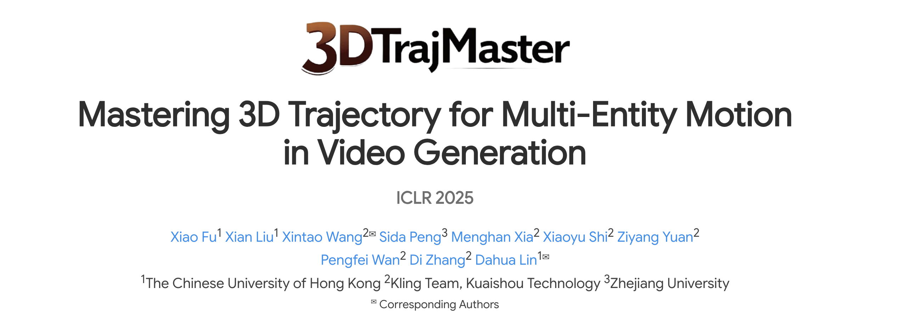

Slide 3
Motivation
As real-world objects move in 3D space, some motion properties can only be described through 3D representations.
Using 2D control signals such as bounding box often fail to capture the inherent 3D object motions.

Slide 4
Motivation
As real-world objects move in 3D space, some motion properties can only be described through 3D representations.
Using 2D control signals such as bounding box often fail to capture the inherent 3D object motions.
Propose: add 3D pose sequences as condition

Slide 5
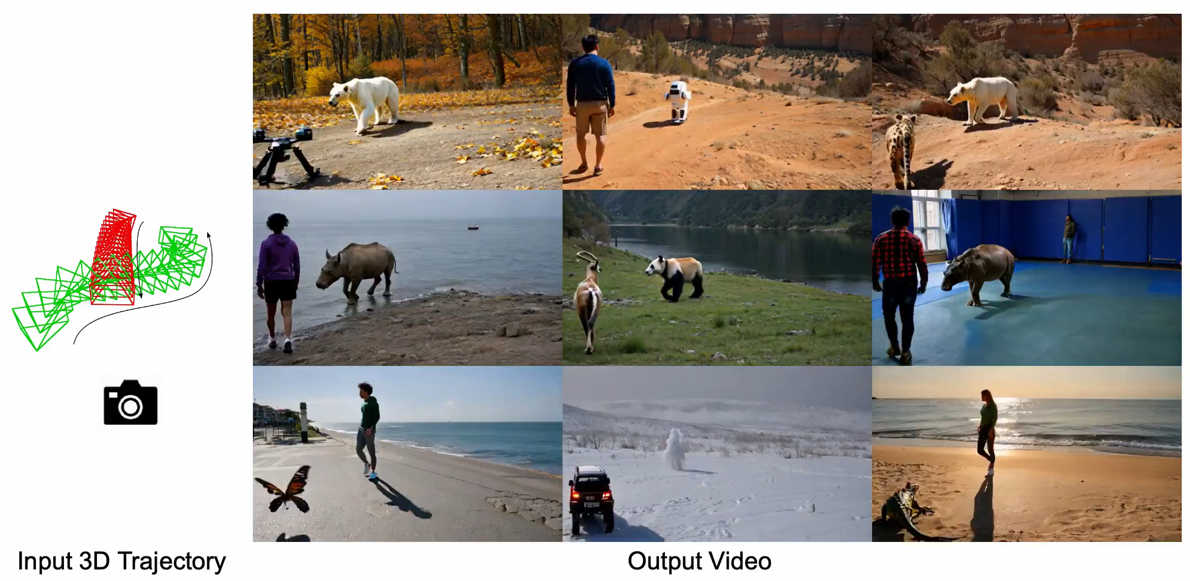

Slide 6
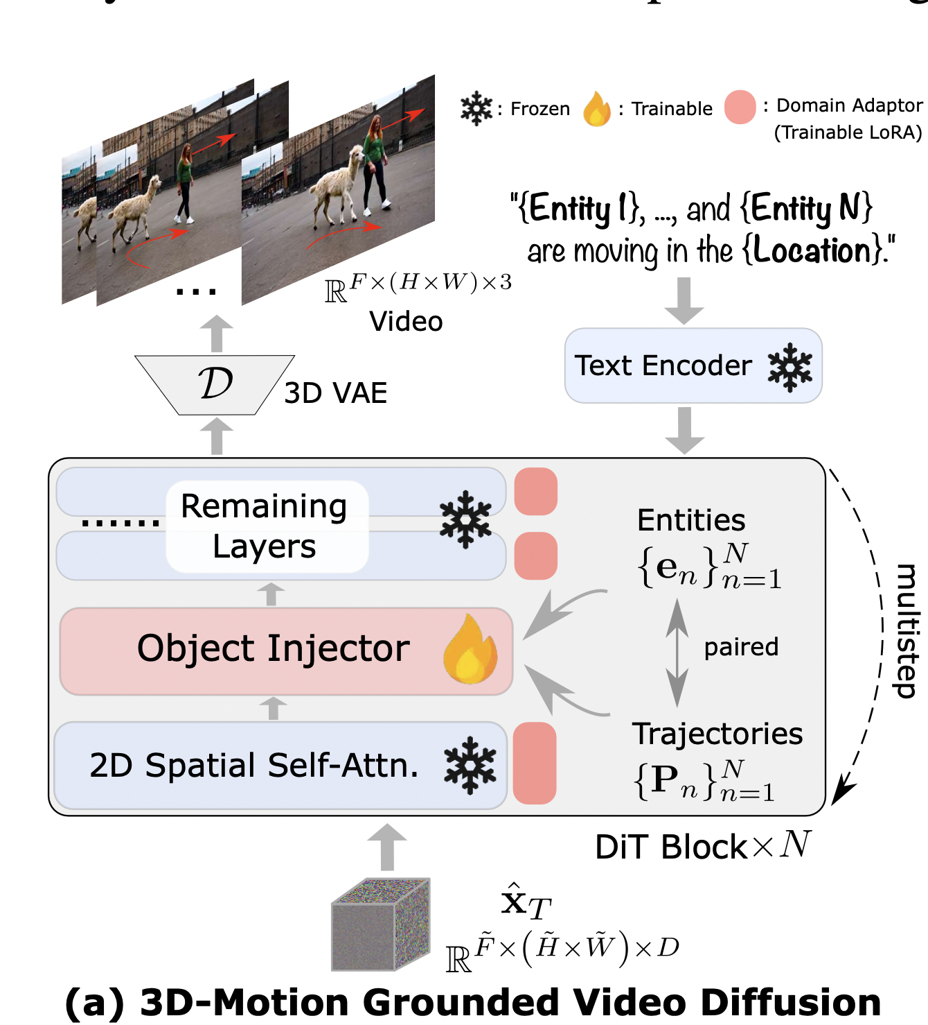
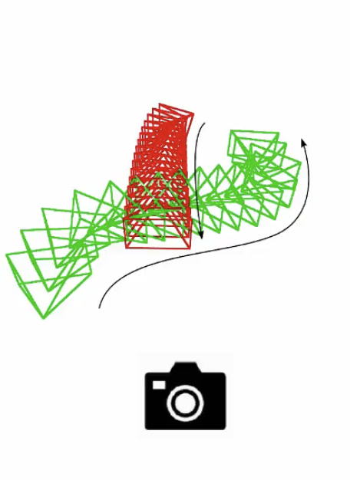
Entity 1: a man with short curly red hair, average build, a black leather jacket, dark blue cargo pants, and white sneakers
Entity 2: a woman with long wavy blonde hair, petite figure, a red floral dress, white sandals, and a yellow shoulder bag
Location: mall lobby
Trajectories:

Slide 7
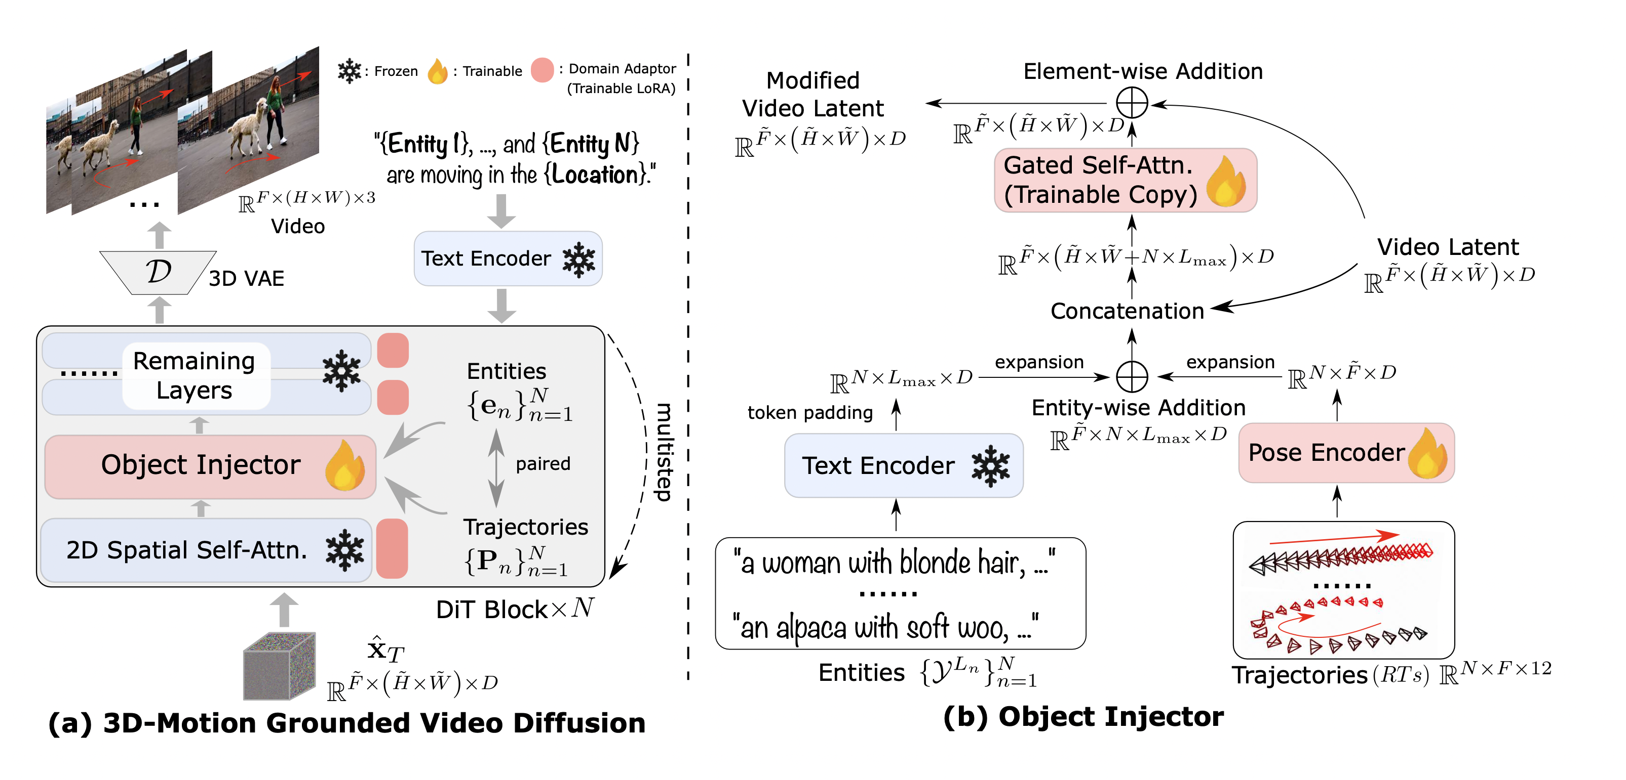

Slide 8
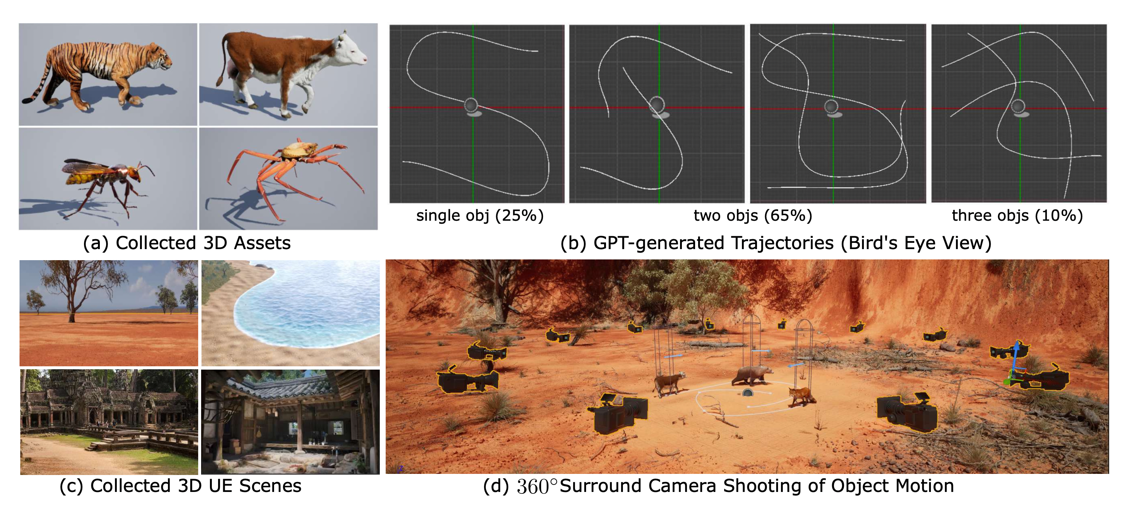
Dataset

Slide 9
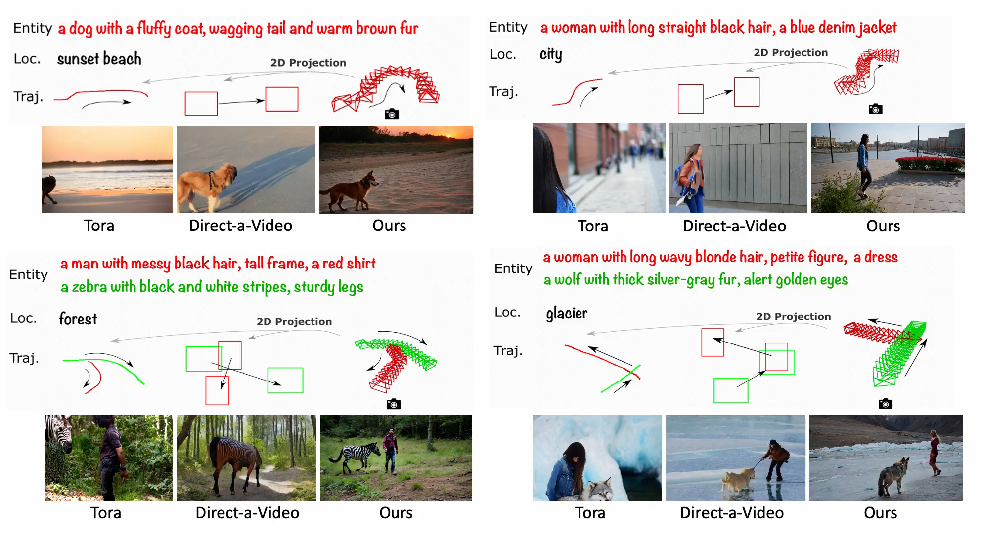
Qualitative Results

Slide 10
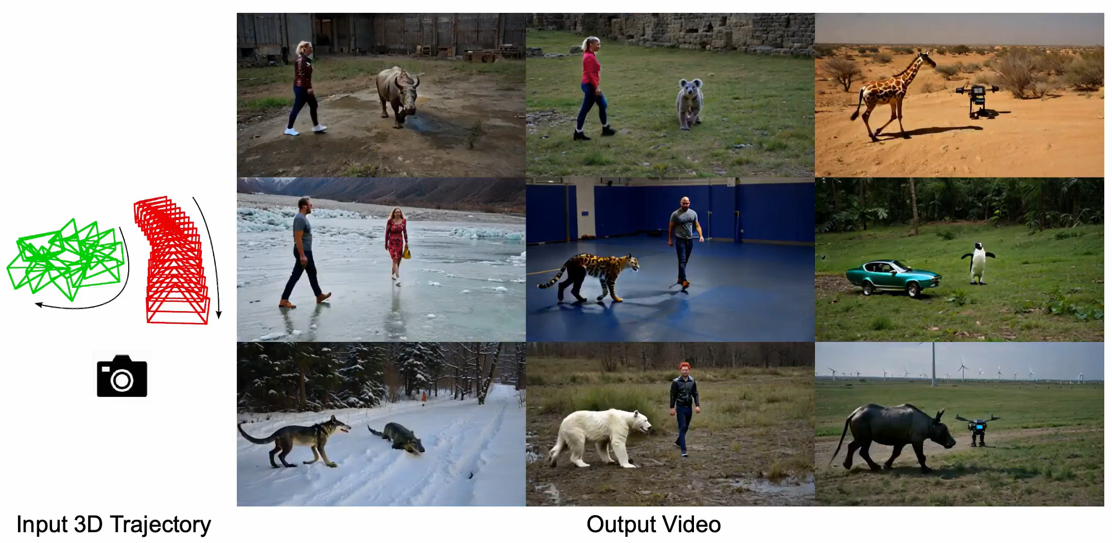

Slide 11
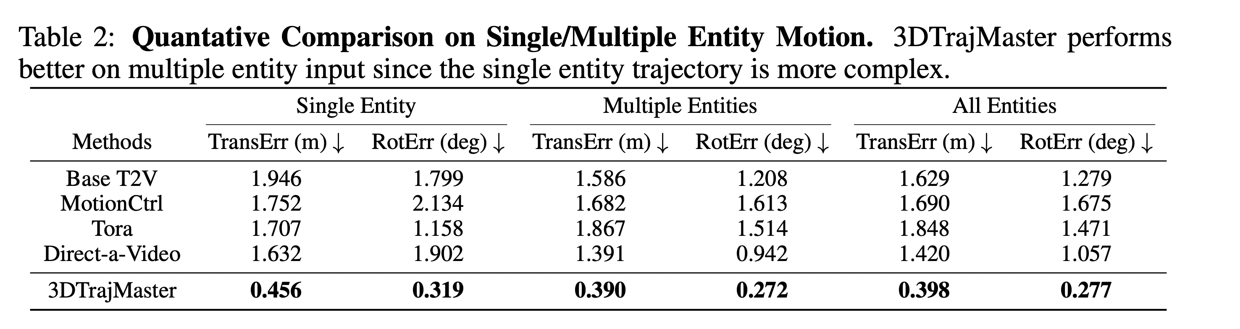
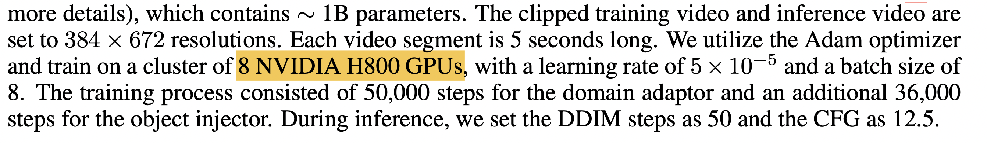
Quantitive Results

Slide 12

(CVPR 2025 Highlight)

Slide 13
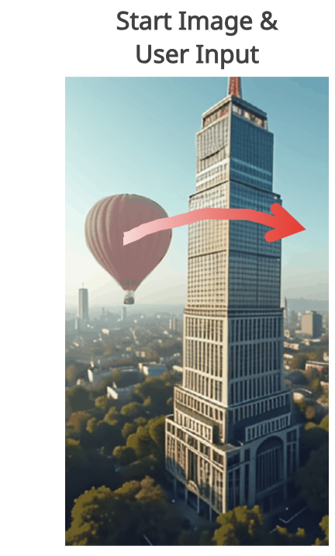

Motivation

Slide 14
Motivation
Propose: add object instance & depth information as condition

Slide 15
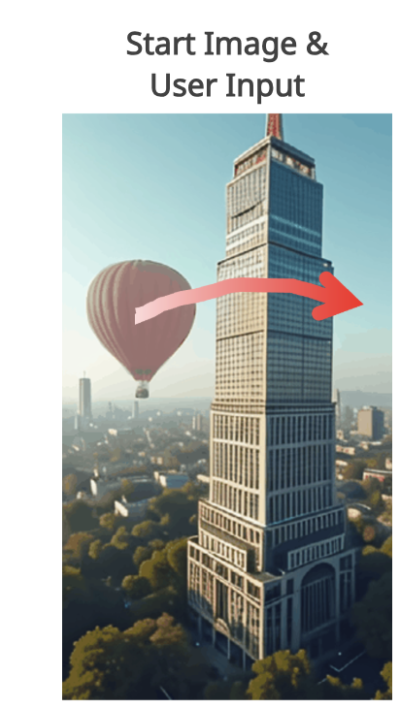

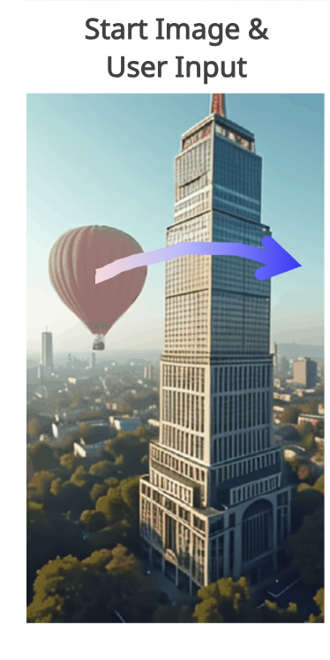



Slide 16
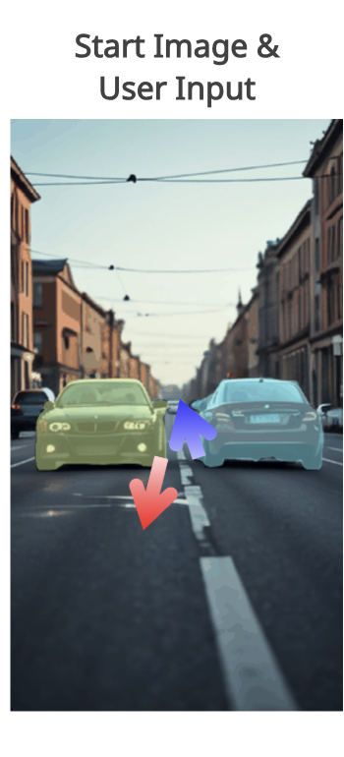
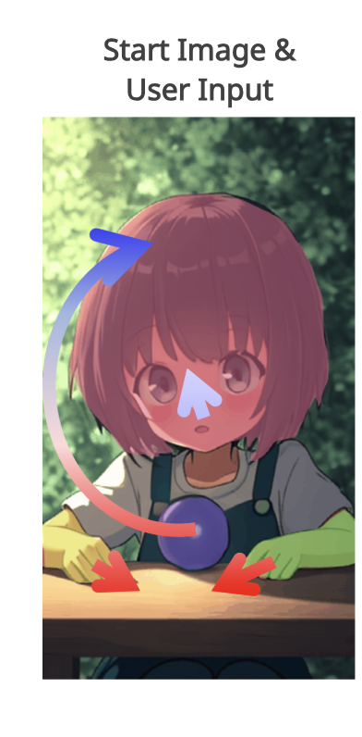




Slide 17
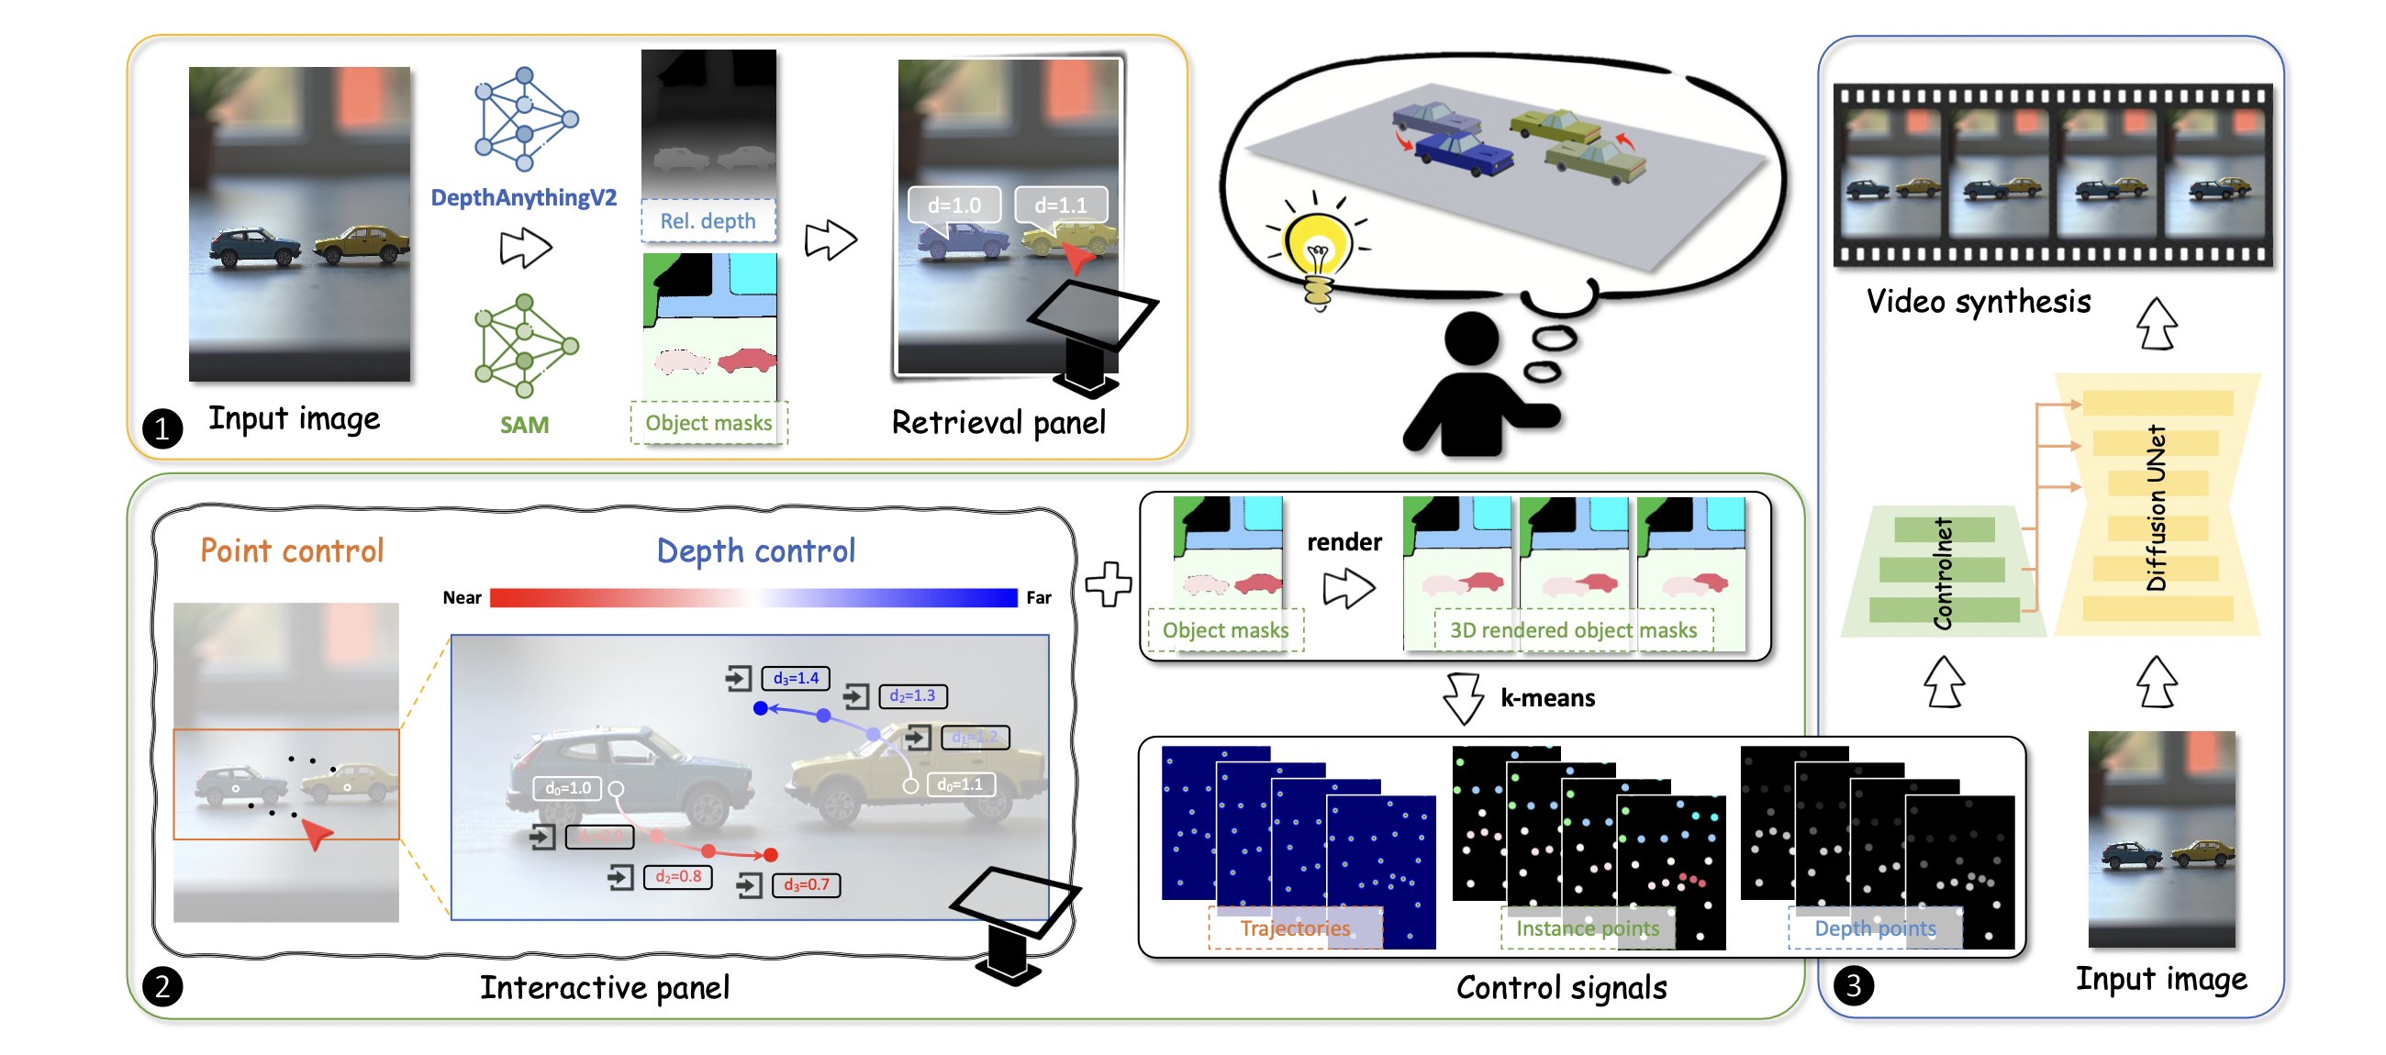
Inference Pipeline

Slide 18
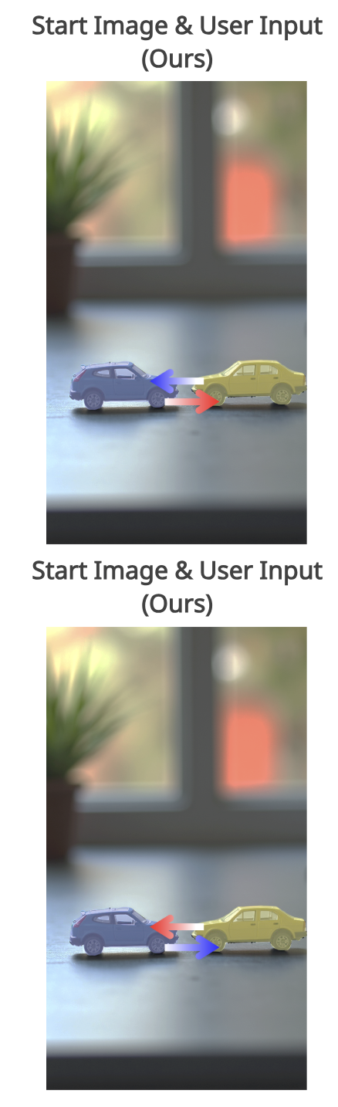

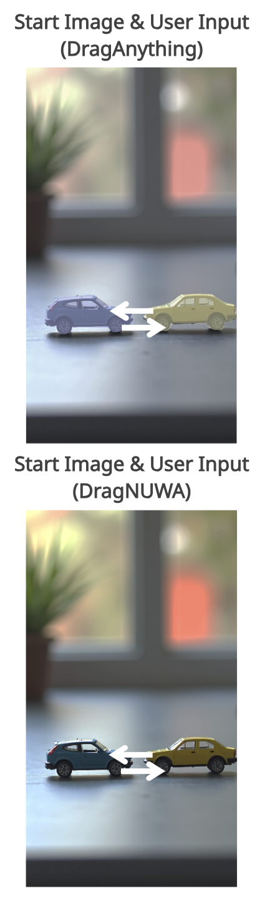






Qualitative Results

Slide 19
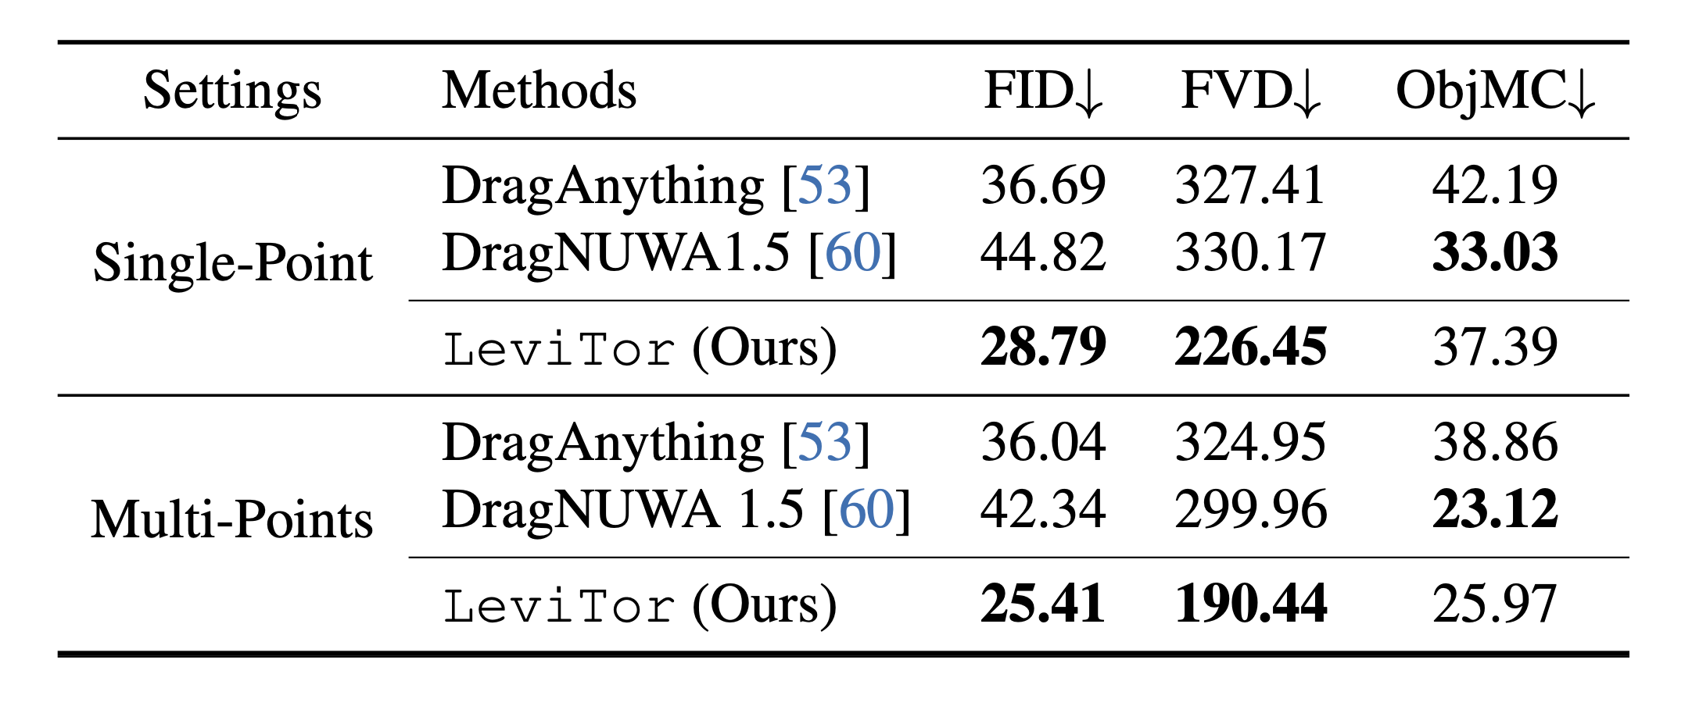
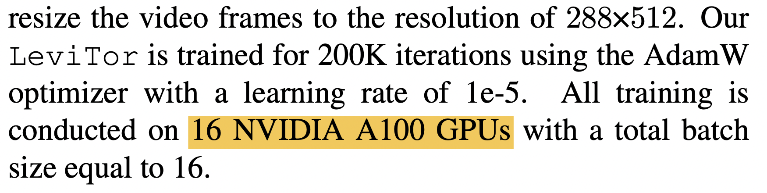
Quantitive Results

